Slide 2
Supersize My Supervisor
Jacqueline Walpole
Notes:
Jacqueline Walpole EMEA Regional Product Manager
Product Manager for Portability

Slide 3
Goal
Provide platform tools to assist our partners in reducing the time and effort required to implement Niagara driven systems
Notes:
More and more systems being implemented are multi-site, multi-jace systems with more and larger supervisors. We’re on a journey to make those Supervisors easier to create and more lightweight in the hope of improving scalability too.

Slide 4
Agenda
In the beginning… Evolution of constructing Supervisors
A step forward… The power of Virtuals
Coming to a Niagara workbench near you soon…
System Database and N4.6 tools

Slide 5
In the beginning… (AX3.0)
Web
Browser
Sup Station
N
N
Web
Browser
B
N
B
B
AX
Supervisor
B
N
B
N
N
JACE
N
JACE2
JACE3
JACE4
JACE#
N
B
N
B
B
B
N
B
B
B
N
B
B
N
B
Notes:
Original AX 3.0 – <CLICK> starting out with your first JACE controller and Supervisor if you wanted to build <CLICK> Supervisor graphics to visualise the data that’s collated in your JACE <CLICK> on your station<CLICK> and view from a web browser <CLICK> either locally or across the web, <CLICK> you create your Supervisor station but you could only visualise what was in that station therefore Sup had to have proxy point for everything it wanted to visualise so you need to create <CLICK> a duplicate of everything you want from the JACE <CLICK> in the Supervisor <CLICK> But, when I add in more and more JACES, <CLICK NEW SLIDE>

Slide 6
In the beginning…
Web
Browser
N
N
N
N
Sup Station
N
N
B
N
B
N
B
N
N
N
B
N
B
Web
Browser
B
B
B
N
N
B
B
B
B
N
B
N
N
B
B
B
AX
Supervisor
B
B
B
B
N
B
B
B
N
B
N
B
N
N
N
B
N
JACE
B
B
N
JACE2
JACE3
JACE4
JACE#
N
B
B
N
B
B
B
B
B
N
B
B
B
B
B
B
B
N
N
N
N
N
N
B
N
B
B
B
B
B
N
B
N
N
B
N
B
N
B
N
B
B
B
B
B
B
B
B
B
B
B
B
B
N
B
N
N
B
N
B
B
B
N
B
N
N
N
N
N
Notes:
they have their points to be visualised too <CLICK> <CLICK>
NOW that’s fine and a valid structure still today. However, AX was originally just a 32 bit application and so had scalability challenges with large system <CLICK>
As no. of connected JACEs increased – <CLICK> the size of the supervisor station increased <CLICK> requiring more java heap memory
Work arounds required tuning heap memory but 32 bit limited practical size

Slide 7
This led to 2-tier systems…
Web
Browser
Sup Station
Config
SUP1
JACE11
JACE12
SUP2
JACE21
JACE22
JACE13
JACE23
Web
Browser
Points all resolved on start up
Master
Supervisor
AX
Supervisor
Notes:
Led to 2-tier system of <CLICK1> "master" sup & localised supervisors that connected to the JACES<CLICK2> where master acts as an aid to navigate to localised supervisors/ appreciate more and bigger boxes, higher spec <CLICK3> translates to MORE money and MORE manpower
In order to create graphics up in your Master Sup <CLICK4> discover the points and draw them into the Sup <CLICK5> folder by folder with separate folders for each device - Difficult to manage as all proxy points no knowledge of structure so had to build that into folder structures
<CLICK> resolve all proxy points to start config db has to run in the RAM of the PC - slow start up if bigger station - <CLICK> rumour has it, it could take up to days!!!

Slide 8
A step forward: Virtuals (AX3.2)
10010110010001101010111101001010
Sup Station
01100100011010011101001010101011
AX
Supervisor
LIVE
N
N
JACE
B
B
N
B
B
N
B
Notes:
<CLICK> Sup station, don’t need to copy all the proxy points into the Sup – instead you simply Enable Virtuals <CLICK> visualise “virtualised” JACE points in your Sup/don’t actually exist on the Sup stn but are available whenever referenced… <CLICK> become more lightweight <CLICK> as components don't need to sit in memory from station start up / also changed from a<CLICK> 32bit to <CLICK> 64 bit appn allowing higher java memory headroom. only useful for <CLICK> live visualisation – and actions Overriding / setting values – but as they don’t actually exist they can’t have alarms, histories or schedules <CLICK> directly associated with them. Alarms not a problem - but linking to histories was still difficult as histories are flattened in the history space so you have completely different paths to navigate to look for histories / schedules required a master/slave

Slide 9
Another step forward: Export Tagging (AX3.4)
Sup Station
AX
Supervisor
Copies Px Views to Sup
Relativizes Px Ords
Virtualizes
New stations come online quicker
JACE
Notes:
no longer recreate your folder structures and graphics on Sup – instead <CLICK> tools for the JACE were added so that Export tags can be added to your config structure in your station so you <CLICK> create the graphics you want for a device on the JACE station and tag your data you want to see and define the structure you want your folders to be built in – you can automatically transfer px views set up in a JACE pushing them up to the Sup
So it takes Px views in the JACE <CLICK> copies them into the Sup <CLICK> in the process it relativises the ords in the process so that the graphics are correct as if viewing from the Sup looking down towards the JACEs and <CLICK> virtualises the points in the process <CLICK>
So for large multi-site systems could reduce time of setting up sup - so as station came online the latest graphics are pushed up to sup

Slide 10
Niagara 4.3 brought us: Virtual Px on Demand
Sup Station
N4
Supervisor
Supervisor pulls Px Views up from JACE
Relativizes Px Ords
JACEs serve all graphics to browser clients
Without needing tunneling - caches locally
No export tags to set up
HOWEVER – can’t query virtuals – need a solution
JACE
Notes:
Since last Summit, as navigate through virtual space as seen from Sup<CLICK> - as you click on things <CLICK> it sucks up views and converts ords to virtuals automatically - nothing to set up e.g. export tags - which is a distributed graphics model
Caches locally when visit - browse from sup and deliver graphics originally held on JACE – something tunneling used to have to be used for
Good for cases with adequate bandwidth to JACE with broadband
Supervisor used for long term data storage, centralized alarming and disaster recovery
Virtuals on demand but cannot neql query any of it as all virtuals

Slide 11
Coming Soon… System Database
When do we get it?
What does it do?
What is it?
How is it set up?
How does it fit in the big picture?

Slide 12
System Database: When do we get it?
Niagara 4.6
General Access
Targeted mid year start Q3
BETA sign up NOW!
on the Tridium Booth
Notes:
This exists – its in n4.6 which is available for beta as soon as we get back from Summit
We’re just working on performance testing right now between now and then

Slide 13
System Database – What does it do?
System Database allows you to:
SEAMLESSLY VISUALIZE your
ENTIRE Niagara system
EASILY navigating through
HIERARCHIES and TAGGING to
SEARCH your entire system
SPEED UP Supervisor configuration
N
E
B
Notes:
Sys Db allows you to <CLICK> <CLICK> <CLICK> <CLICK> <CLICK> <CLICK>
And now with the enhancements that we’ve been making to the html5 views and objects and virtuals, it means its not <CLICK> just for points and their actions but also alarms and schedules too

Slide 14
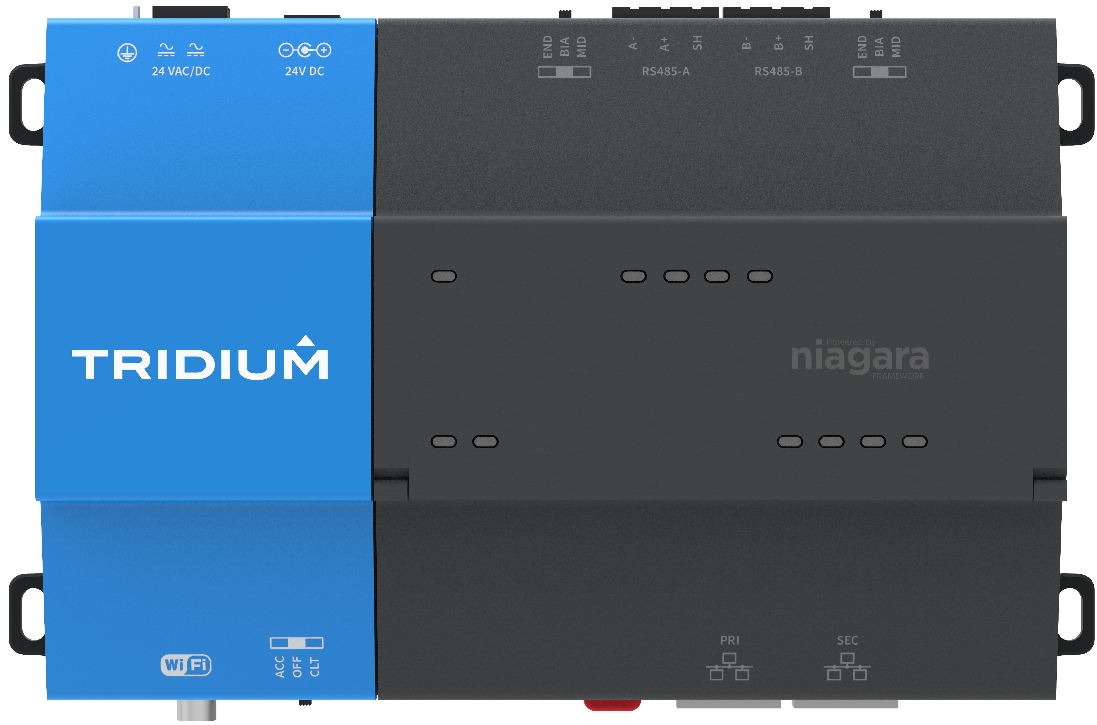
System Database – What is it?
Sup Station
Notes:
We have provided an Orient Database plug-in which is simply added to a Supervisor station from a palette – we provide a working example in the palette that you can use out of the box
The database starts out empty – and is populated by Indexing – again the details will follow as the queries you use for this are fully configurable – but the out of the box defaults ought to do everything you need
So when the index runs its queries, <CLICK> it gathers details of all the points in your Niagara network and saves this information in the database <CLICK>

Slide 15
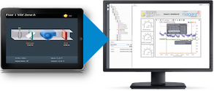
System Database – What is it?
Sup Station
v
Notes:
But what can we use this information stored in the System Database for?
Well, for one thing we can use it to <CLICK> build hierarchies and therefore use these to navigate through the entire connected Niagara network using Virtuals <CLICK> and with the Virtual Px Views loaded on demand – the graphics are served up as you navigate around the system and

Slide 16
System Database – How is it set up?
SystemDatabaseService
Notes:
I’ll take you through this step by step. I have a clip that I prepared earlier…

Slide 17
Demonstration video
Notes:
<PLAY AUTO> I’m starting with a Supervisor station and want to add a System Database Service – using the palette:
NiagaraSystemIndex - you’ll see there is a Typical Configuration folder on there which contains the SystemDatabaseService pre-configured for a Typical Configuration :S
Drag this into the Services folder of your Supervisor station
If you look at the Property Sheet you’ll see it’s in fault to start with – this prevents it from firing up the minute you drag it on - in System Database Type Selection – select OrientDB to turn it on – as I mentioned earlier, this future-proofs to allow different NoSQL database platforms to be utilised in the future

Slide 18
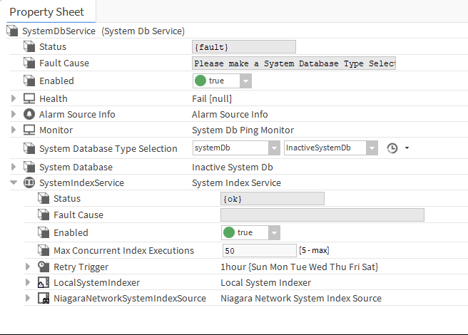
System Database – How is it set up?
Notes:
So, as explained earlier, to populate the database, it needs to be indexed using some queries
If we look at the Property Sheet of the System Db Service <CLICK>the SystemIndexService sits under here <CLICK> Local System Indexer – looks locally in the Supervisor Station – this isn’t enabled by default but you can turn it on if you wish - I’ll be concentrating on the Niagara Network System Index Service today

Slide 19
System Database – How is it set up?
3 Ways to Index a System Database
Global Niagara Network Indexer
runs on the Supervisor at defined intervals
queries are run to pull information from connected devices

Slide 20
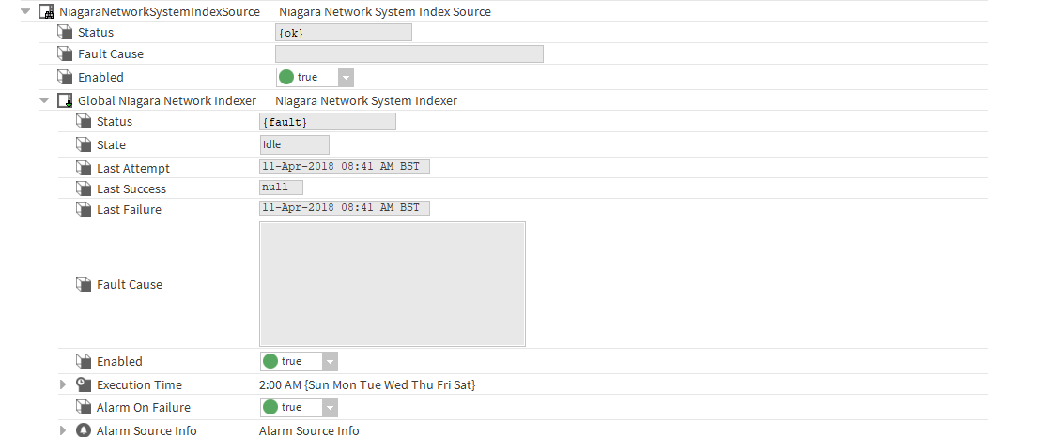
System Database – How is it set up?
Notes:
…If we unfold the <CLICK> NiagaraNetworkSystemIndexSource which is enabled by default and <CLICK> GlobalNiagaraNetworkIndexer

Slide 21
System Database – How is it set up?
Notes:
…and you’ll see the Default Index Queries and there is a section for you to write Custom Queries if you wish and the option to either merge these together or only use Custom

Slide 22
System Database – How is it set up?
3 ways to index a System Database
Global Niagara Network Indexer
runs on the Supervisor at defined intervals
queries are run to pull information from connected devices
Individual device Index: Supervisor pulls from specific JACE
run on Supervisor on demand
Individual device Index: JACE push to Supervisor
run on JACE on demand
Notes:
The other two options allow you to on demand to index a single device or <CLICK> from the JACE you can tell the Supervisor to index it

Slide 23
System Database – How is it set up?
N4.6+
Sup Station
2 AM
N4.4+
N4.6+

Slide 24
System Database – What is it?
Sup Station
Notes:
If you recall the key to utilising the information stored in the System Database is that you can build your hierarchies on the data – and to achieve this we’ve created 2 new Ord schemes

Slide 25
System Database – What is it?
2 new Ord schemes
nspace:
included in Niagara 4.4
nspace > station name – shortens need to define Virtuals
note: cannot have duplicated station names in a Niagara network
whole Niagara network including supervisor station
sys:
included in Niagara 4.6
queries the system database only
Notes:
You’ll also find 2 new ord schemes for navigating to and querying your data
Nspace flattens to station name – negates the need for defining the network and long-winded virtual ord path
Sys: searches the System Database only – this is particularly useful when defining the Scope of your Hierarchy search

Slide 26
Where does it fit in the big picture?
N4.6
Notes:
Perhaps the best way to explain its use is to show you an example – and demonstrate how this and some of our other recent tools work together to help reduce the engineering time of deploying new sites and incorporating them into a Supervisor.
If you’ve attended some of the other sessions here during the past 2 days you’ll have seen a lot of the detail of these but hopefully I can demonstrate them working together. We’ve got some demos of these tools out on the Tridium booths so do drop by and see them for yourselves

Slide 27
HTML5 Views
Templates
Tagging
Responsive
Hierarchies
Virtual Px Files on Demand
Virtual Schedules
Bulk Deployment
Notes:
The key to the demo is to utilise all the new and recent features working together

Slide 28
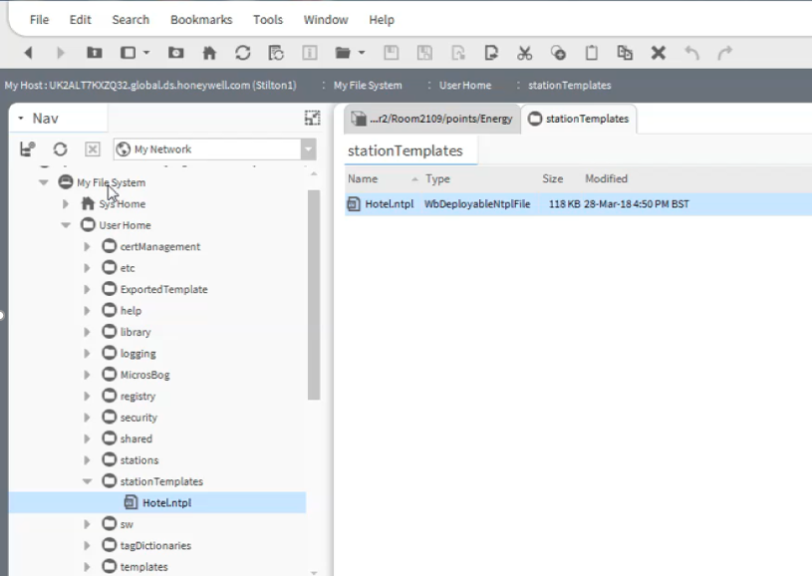
Example: Travelling (Tridium) Salesman
HOTEL GROUP
- SUPERVISOR
HOTEL
- JACE
TAG DICTIONARIES
Niagara
Haystack
Custom
HIERARCHY
TAG DICTIONARIES
HIERARCHY
BACnet NETWORK
MICROS FIDELIO
STANDARD
FLOOR
DELUX
Notes:
You may have seen Nick Dodd’s presentation on IoT communications protocols and his example of using MQTT alongside our Micros Fidelio driver setting hotel room occupant preferred set point.
In the following videos, I’m starting out with a bare bones Supervisor - Contains Hierarchy, TagDictionary, Bacnet network (unpopulated) and Micros network (populated) and nothing more
And deploying a hotel which starts out as just a bare bones JACE (remote station) Contains Hierarchy, TagDictionary, Bacnet network(unpopulated) and Micros network (populated) – add Floors of Standard or Deluxe rooms from bulk deployment spreadsheet
The most common repetition elements to the installation have been identified, in this example, Floor information and Room styles such as Standard room or Delux room according to the site Specification. Templates for these elements have been created to enhance the speed of engineering a system. The Templates contain the relevant configuration parameters for Naming and linking.

Slide 29
Demonstration video
Export Templates to Excel
Notes:
As we will make use of the Bulk Deployment method being introduced in 4.6, we will need to prepare a customised spreadsheet that the feature will utilise to import and configure the station to meet specific installation requirements. <CLICK>
This is achieved via the Template sidebar – Export Config option. The spreadsheet is formatted during the export process, in readiness to add site specific information.

Slide 30
Demonstration video
Configuration Spreadsheet
Notes:
Opening the spreadsheet we can see that certain elements are required to be configured and some elements are optional but will be information used to uniquely configure the structure and identify elements within the station. Hints are available in most cells to assist in entering the parameters correctly. Additional ‘Configs’ may be present if the source template contains a requirement for input or output linking to ongoing components or naming conventions, at the time of deployment. Geo Location Tags. One completed

Slide 31
Demonstration video
Bulk Deployment
Notes:
<PLAY> so let’s use this spreadsheet – Template Service – bulk deploy from Excel – just open the Config to show the Bacnet network – watch here as it runs – see the floors created almost immediately – then delux then standard - only 1 minute 30 seconds

Slide 32
Demonstration video
On the Supervisor: Discover the new Hotel
Notes:
Here we return to our empty Supervisor station – discover what is connected to its Niagara network – here’s our hotel
So lets connect to it and enable Virtuals
There’s nothing in its Points – but in the Virtual space there’s all the Floors and Rooms STOP

Slide 33
Demonstration video
On the Supervisor: Import Virtual Px Files on Demand
Notes:
And for the Niagara Network we want to ensure that we check the Virtual Policies and turn on Import Virtual Px Files on Demand

Slide 34
Demonstration video
On the Supervisor: Hierarchy Scope
Notes:
So, the last thing that’s needed to configure is to set the Hierarchy scope

Slide 35
Demonstration video
On the Supervisor: Find a New Hotel in the System Database
Notes:
So, here we go… going to manually Execute the Index of the System Database – In Progress –> Idle – Still no Points here but just going to take a look at the virtual Space and confirm that its bringing through Virtual Px on Demand – 2108 – Look at the Hierarchy in the Supervisor – refresh – here’s our hotel and rooms and if we pick another room – here’s the Px

Slide 36
System Database – What is it?
Sup Station
v
Notes:
<CLICK> from the hierarchies and use these to navigate through the entire connected Niagara network using Virtuals <CLICK> and with the <CLICK> Virtual Px Views loaded on demand – the graphics are served up as you navigate around the system and you have the other views that have been virtualised such as GRIDS and SCHEDULES

Slide 37
Our Aim
Templates
Hierarchies
HTML5 Views
Responsive
Tagging
Virtual Px Files on Demand
Virtual Schedules
Bulk Deployment
SEAMLESSLY VISUALIZE your
ENTIRE Niagara system
EASILY navigating through
HIERARCHIES utilising TAGGING to
SEARCH your entire system
SPEED UP Supervisor configuration
Notes:
So – with System database you can…. Using…

Slide 38
Goal
Provide platform tools to assist our partners in reducing the time and effort required to implement Niagara driven systems
Notes:
I hope you can agree that this takes another step forward to achieving our goal

Slide 39
Thank you – any questions…?
Jacqueline Walpole
jacqueline.walpole@tridium.com
Notes:
Thank you for your patience – any questions
Gareth Johnson and Scott Hoye to assist with technical queries

